Slide 1
Award Entry: Tips
A robust award entry can be put together in 2-3 hours. Allow yourself enough time to do it and get it proofread before you send it.
Award entries do well when they focus on:
Why the acoustic design of the project was important to the client/end users
What is special about the acoustics of the project (not the status or appearance of the project)
How you overcame challenges (there are ALWAYS challenges!)
How you worked with and liaised with the client and/or end users
How you impressed your client

Slide 2
Award Entry: Tips
Get testimonials from your client as early in the process as possible – ask for them now for any project you might enter
Consider writing an example testimonial for your client and asking them to provide something similar (our clients are often time poor and this can be a way of making it easier for them to provide a testimonial)
You can submit a “holding” testimonial – for example, if your client is waiting for sign-off from their marketing team
Get good-quality photos for the scheme from the architect (make sure you ask for these in good time prior to the deadline)

Slide 3
Award Entry: 2022 Building Acoustics Winning Entry Form
Focused on collaboration between two consultancies as a unique challenge and success
Focused on the high and complex acoustic requirements of the scheme
Demonstrated the lessons learned during the design process
Had positive testimonials from both the client and the end user

Slide 4
ANC Awards: The Benefits
Improved company profile within the industry
You can celebrate award success with your client and they can promote you as their award-winning acoustician
You can use the ANC Award Winner logos on email footers, your website, and anywhere else you see fit – reminding your other clients that you are an award-winning acoustic consultancy

Slide 5
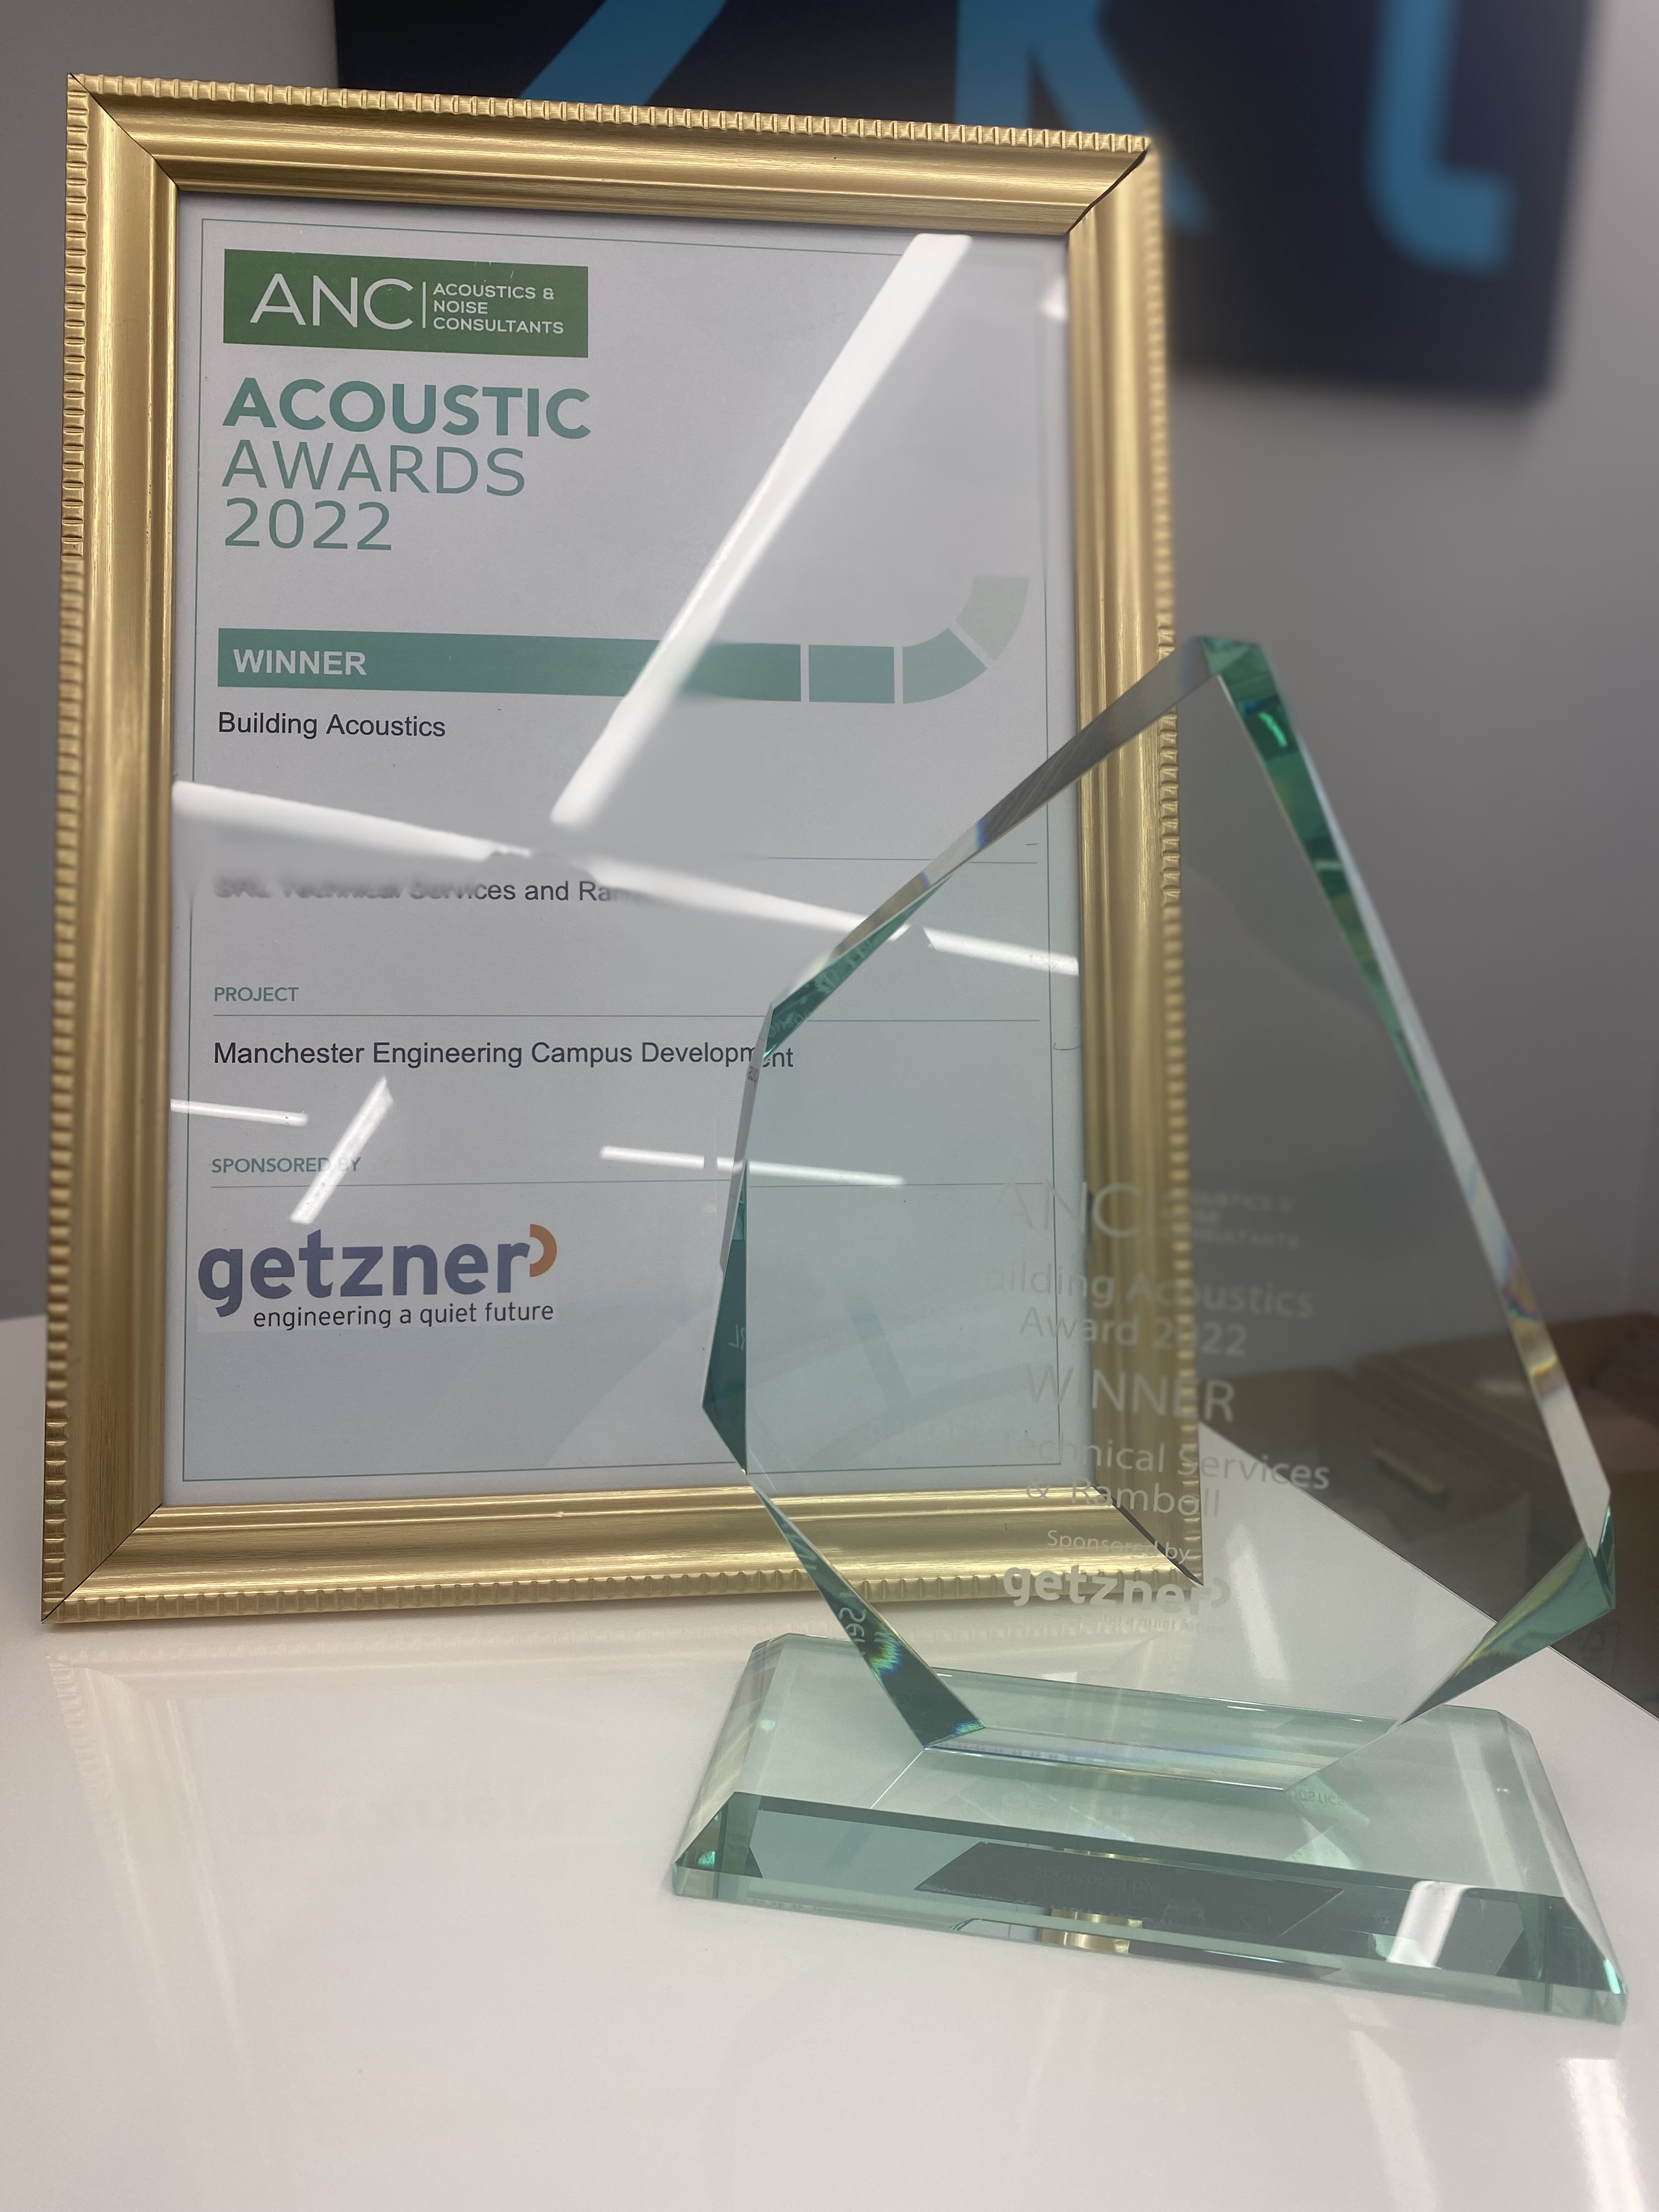
ANC Awards: The Benefits
A lovely trophy that can have pride of place in your office

